Slide 1

A features-based machine learning prediction model for sentiment analysis on social media
Group members:
- Jessica Sarah Deen
- Shreyash Ingole
- Rohit Gore
- Harsh Agnihotri
- Paavan Gupta
Project Guide:
Dr. Kannan Shanmugam

Slide 2
Introduction
Sentiment analysis is the process of identifying and classifying sentiments expressed in text as positive, negative, or neutral.
Social media has become an extremely important factor for consumer facing organizations to consider today.
With millions of new tweets every day creating a huge dataset, Twitter can be used to directly understand customers’ feelings or opinions towards a product or brand.

Slide 3
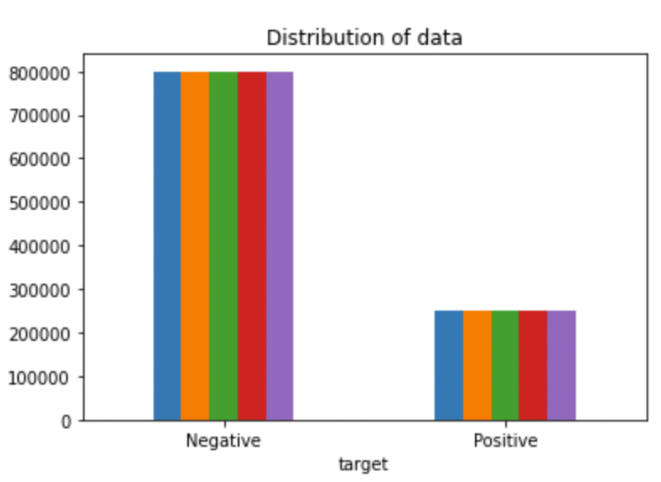
Existing work
Importing necessary dependencies and datasets to python
Shaping and pre-processing data
Cleaning the dataset by removing punctuations, null values, single letter words, URLs, etc.
Output

Slide 4
Limitations
Sarcasm, irony, jokes, negations, and exaggerations
Lack of context with tweets being quite short
Size of datasets
Time frame
Specific products

Slide 5
Problem Statement
On Social networking websites like Facebook and Twitter ,there is a possibility that people express their valuable opinions on products and services.
Any organization cannot afford to have a blind eye to these feedback.
Sentiment analysis in the micro-blogging domain is a relatively new research topic, so there is still a lot of room for further research in this area.
Many researchers have suggested supervised learning techniques such as Naive Bayes, Decision Tree, Logistic Regression, and Support Vector Machines.

Slide 6
Proposed Work
The proposed methodology has been used for sentiment classification based on tweets datasets.
The proposed aim for sentiment analysis is to use different machine learning algorithms.

Slide 7
Methodology
DATASETS
DATA PREPROCESSING
FEATURE EXTRACTION
BAG OF WORDS
TERM FREQUENCY-INVERSE DOCUMENT FREQUENCY (TF-IDF)

Slide 8
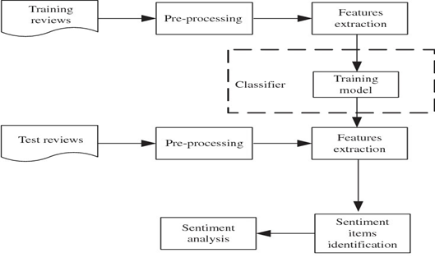
Flow Diagram

Slide 9
Novelty Of Our Project
Our Study aims to try to show the basic way of classifying tweets into positive or negative categories.
The use of sentiment analysis in product analytics stems from reputation management.
The most basic way to apply sentiment analysis is to gather and categorize feedback for further improvements.
The sentiment analysis algorithm can do the dirty work and show what kind of feedback goes from which audience segment and what it points.

Slide 10





Real Life usage of Sentimental Analysis:
Let’s look at the most popular applications of sentiment analysis in real life:
Social media monitoring
Customer support
Customer feedback
Brand monitoring and reputation management
Product analysis
Market and competitor research

Slide 11
Hardware Requirements:
Ram : 8 GB Ram and more
Processor : Intel® Core ™ i3 5th Gen Processor
HardDisk : 1TB and more
Speed : 1GHZ and more
Software Requirements:
Operating System : windows 10 and higher versions
System Type : 64-bit Operating System, x64 based processor
Language : Python
Hardware and Software requirements for Sentiment Analysis:

Slide 12

COMPLETE MODULE SPLIT-UP AND EXPLAINATION

Slide 13
Table of Contents:
Understand the Problem Statement
Tweets Preprocessing and Cleaning
Story Generation and Visualization from Tweets
Extracting Features from Cleaned Tweets
Model Building: Sentiment Analysis

Slide 14
Understand the Problem Statement
The objective of this task is to detect hate speech in tweets. For the sake of simplicity, we say a tweet contains hate speech if it has a racist or sexist sentiment associated with it. So, the task is to classify racist or sexist tweets from other tweets.

Slide 15
Tweets Preprocessing and Cleaning
You are searching for a document in this office space. In which scenario are you more likely to find the document easily? Of course, in the less cluttered one because each item is kept in its proper place. The data cleaning exercise is quite similar. If the data is arranged in a structured format, then it becomes easier to find the right information.

Slide 16
Tweets Preproc-essing and Cleaning is divided into 5 topics
Removing Twitter Handles
Removing Punctuations, Numbers, and Special Characters
Removing Short Words
Tokenization
Stemming

Slide 17
Story Generation and Visualization from Tweets
It is divides into four parts
A) Understanding the common words used in the tweets
B) Words in non-racist/sexist tweets
C) Racist/Sexist Tweets
D) Understanding the impact of Hashtags on tweets sentiment

Slide 18
Extracting Features from Cleaned Tweets
It is divided into two parts:
Bag-of-Words Features
TF-IDF Features

Slide 19
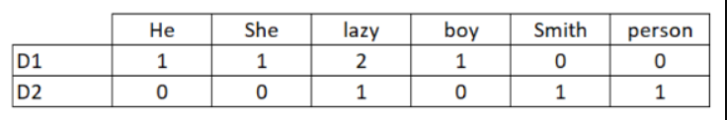
Bag-of-Words Features
Bag-of-Words is a method to represent text into numerical features. Consider a corpus (a collection of texts) called C of D documents {d1,d2…..dD} and N unique tokens extracted out of the corpus C. The N tokens (words) will form a list, and the size of the bag-of-words matrix M will be given by D X N. Each row in the matrix M contains the frequency of tokens in document D(i).
Let us understand this using a simple example. Suppose we have only 2 document
D1: He is a lazy boy. She is also lazy.
D2: Smith is a lazy person.
The list created would consist of all the unique tokens in the corpus C.
= [‘He’,’She’,’lazy’,’boy’,’Smith’,’person’]
Here, D=2, N=6
The matrix M of size 2 X 6 will be represented as –

Slide 20
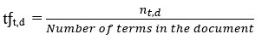
TF-IDF Features
This is another method which is based on the frequency method, but it is different to the bag-of-words approach in the sense that it considers, not just the occurrence of a word in a single document (or tweet) but in the entire corpus.

Slide 21
Model Building: Sentiment Analysis
We are now done with all the pre-modelling stages required to get the data in the proper form and shape. Now we will be building predictive models on the dataset using the two-feature set — Bag-of-Words and TF-IDF.

Slide 22
Demo Video

Slide 23
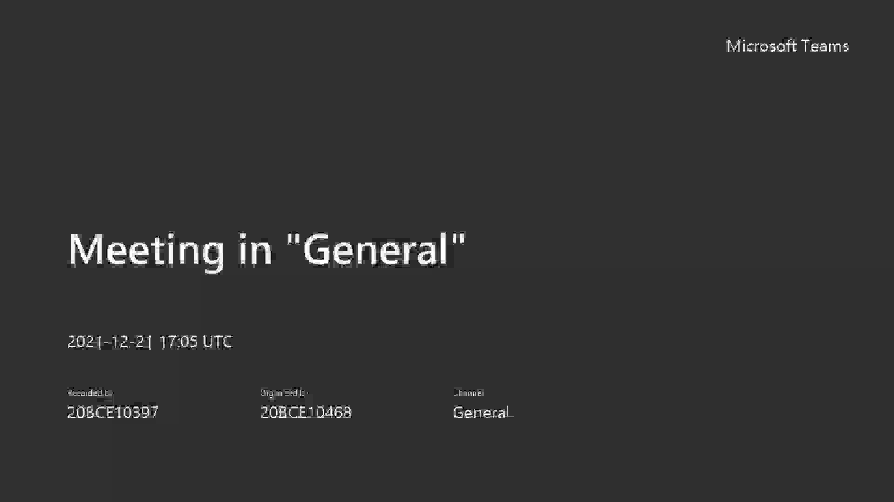

Slide 24
Result and Discussion
Data Pre-processing
Visual Representation
Feature Extraction

Slide 25
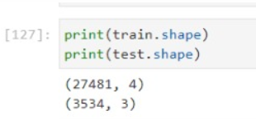
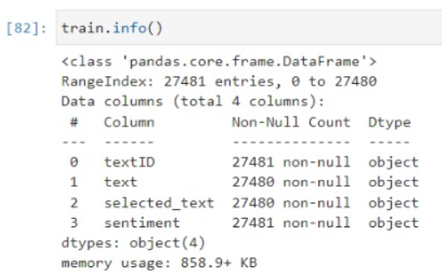
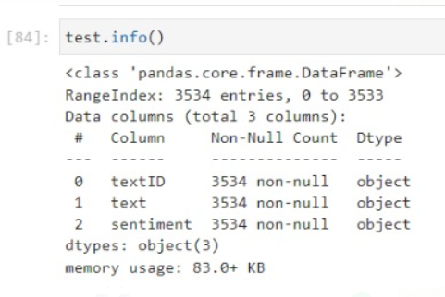
Data Pre-processing
In this study pre-processing includes cleaning(remove redundant data), normalization, and splitting.
The split() method in Python is used for selected training datasets.
The training model implies a validation set used to help tune the hyperparameters of the trained model and lead to better performance.

Slide 26
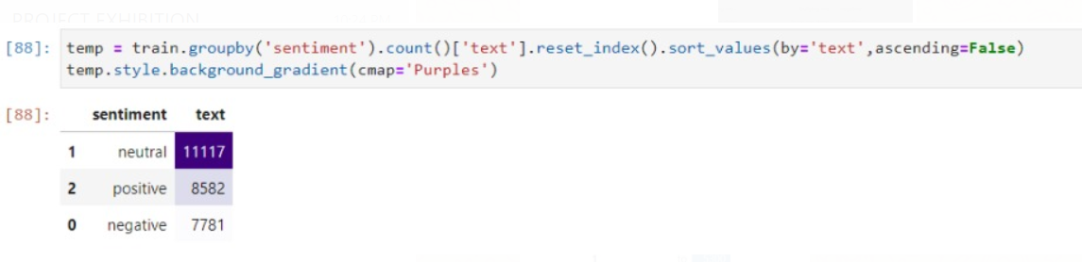
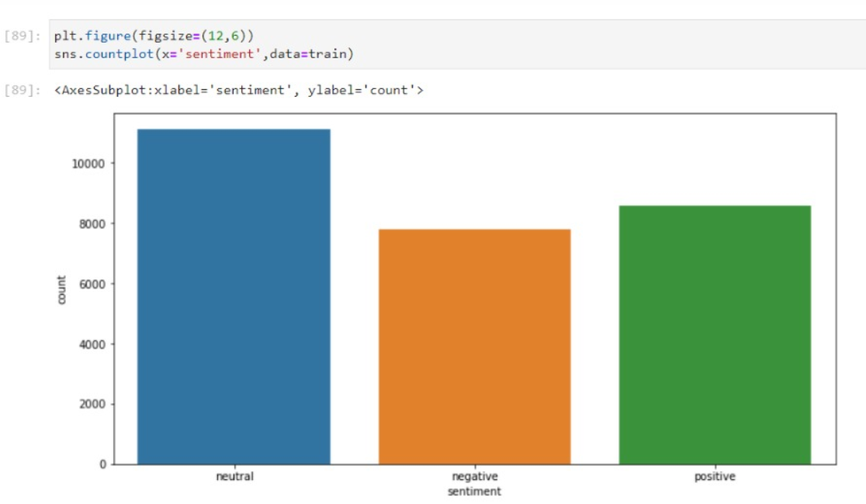
Visual Representation

Slide 27
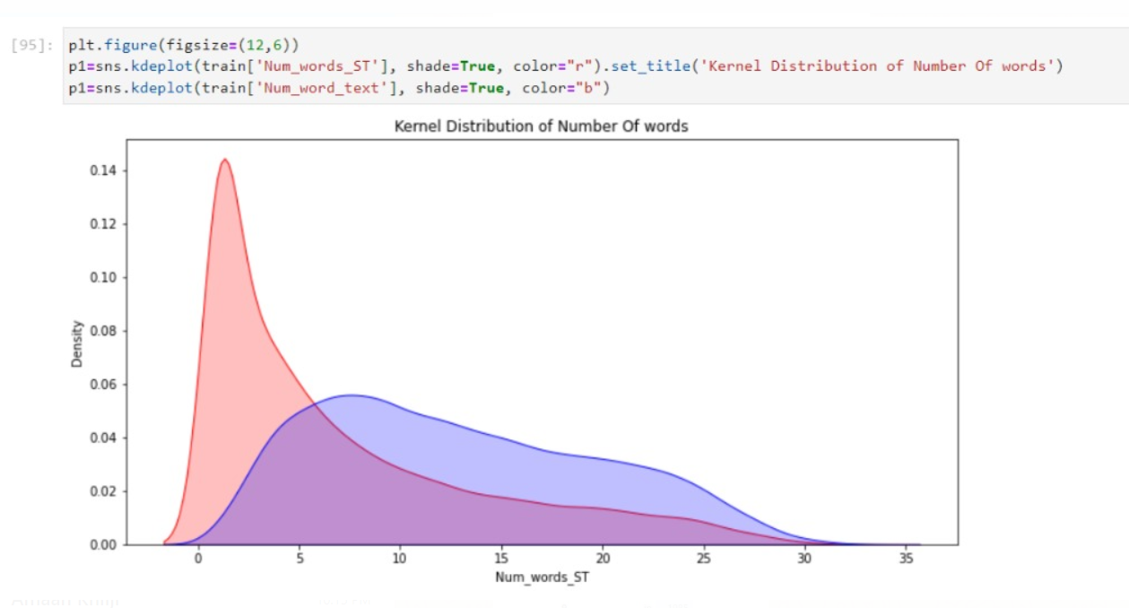
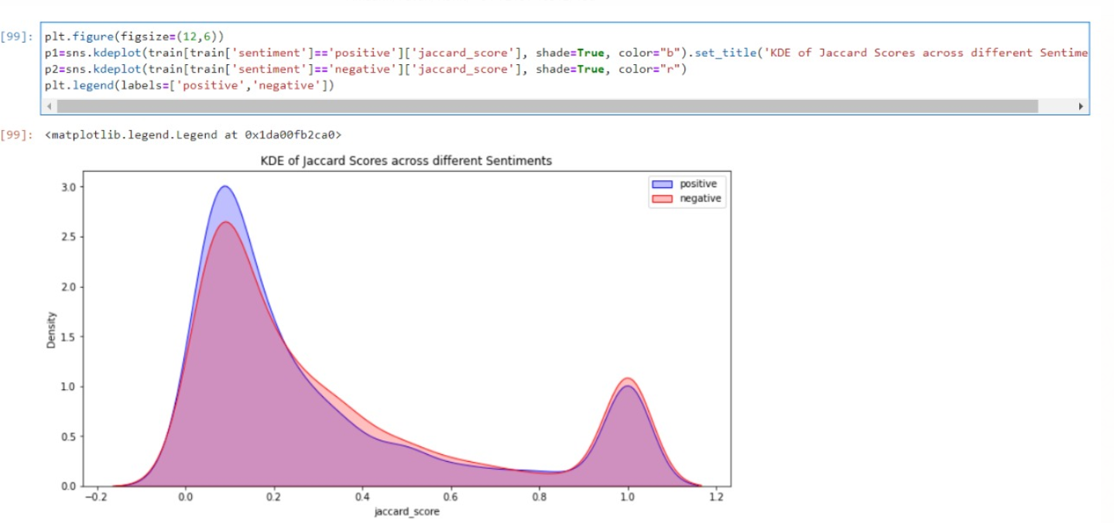
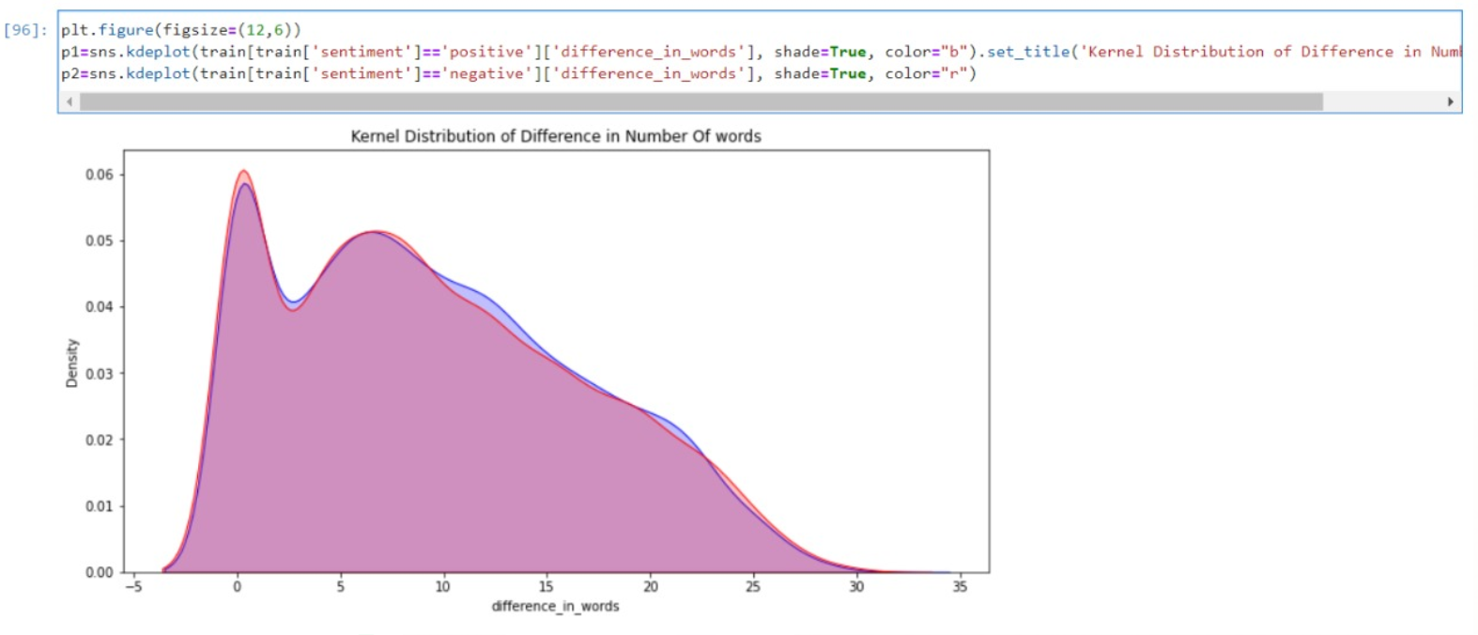
Graphical Representation
Kernel distribution of no. of words
Kernel distribution of difference in no. of words
KDE of Jaccard score across different sentiment

Slide 28
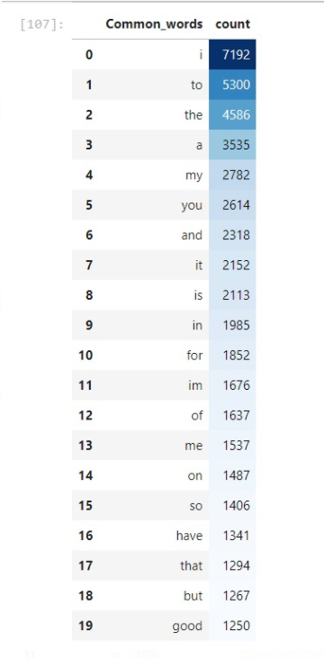
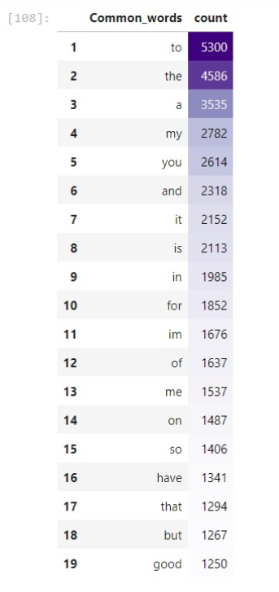
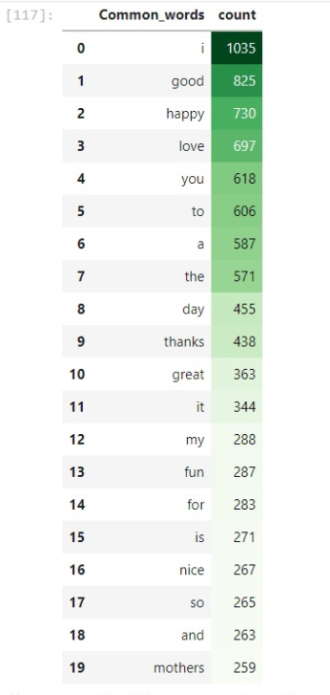
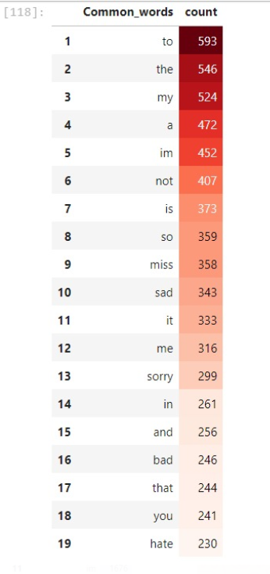
Common Word Count

Slide 29
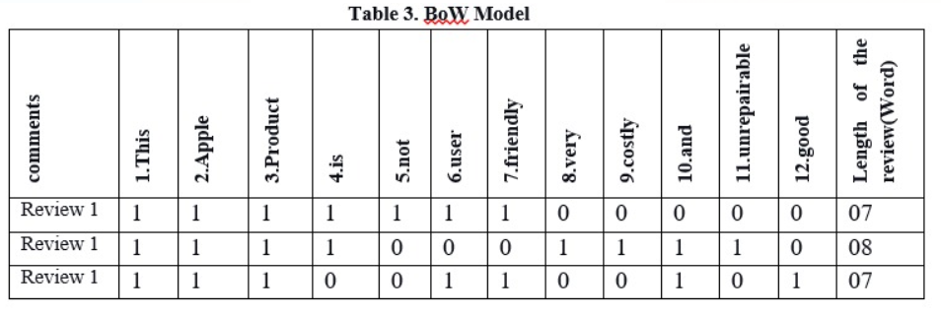
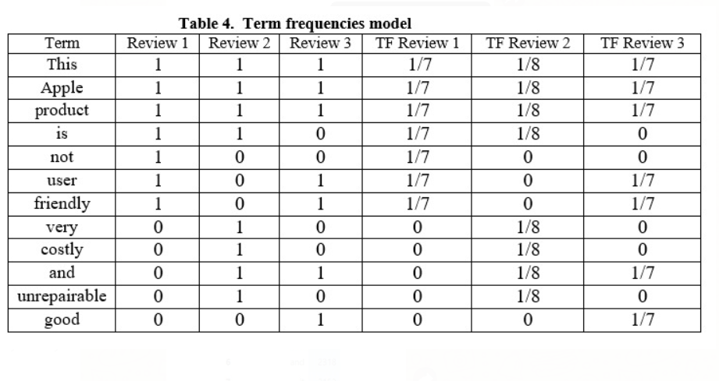
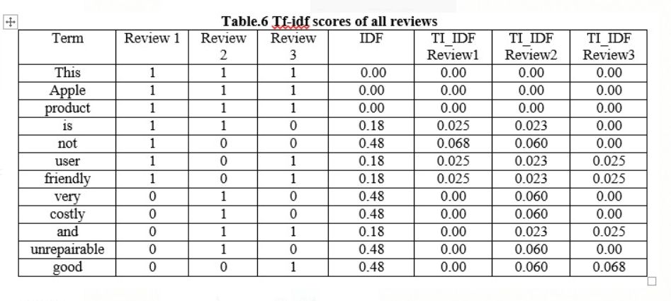
Feature Extraction

Slide 30
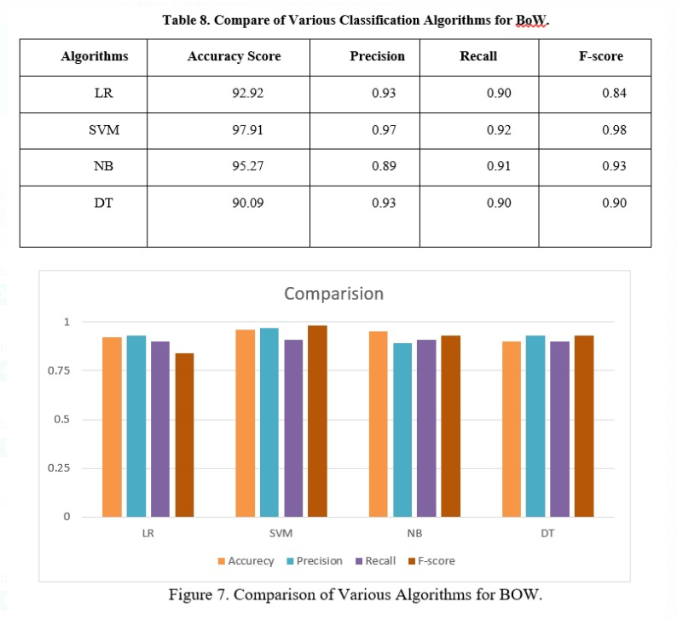
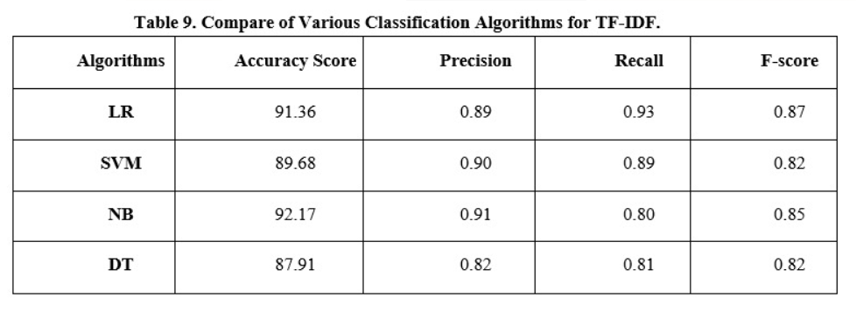
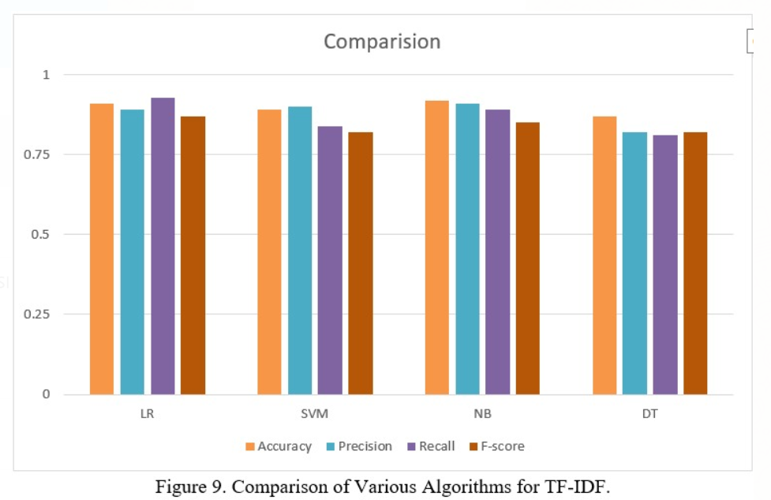
Comparison of Various Classification Algorithm

Slide 31
Conclusion
The enhancement of model Bag-of-words (BoW) and term frequency-Inverse document frequency(tf-idf) comments on English language sentiments.
The basic way of classifying tweets into a positive or negative category using the classifier as a baseline and working language models based on features.
Using more hybrid methods can provide a more accessible way of feature selection and direction for sentiment analysis.

Slide 32

THANK YOU

